Slide 1

GPs are on your side

Slide 2

Like you, GPs want:

Slide 3
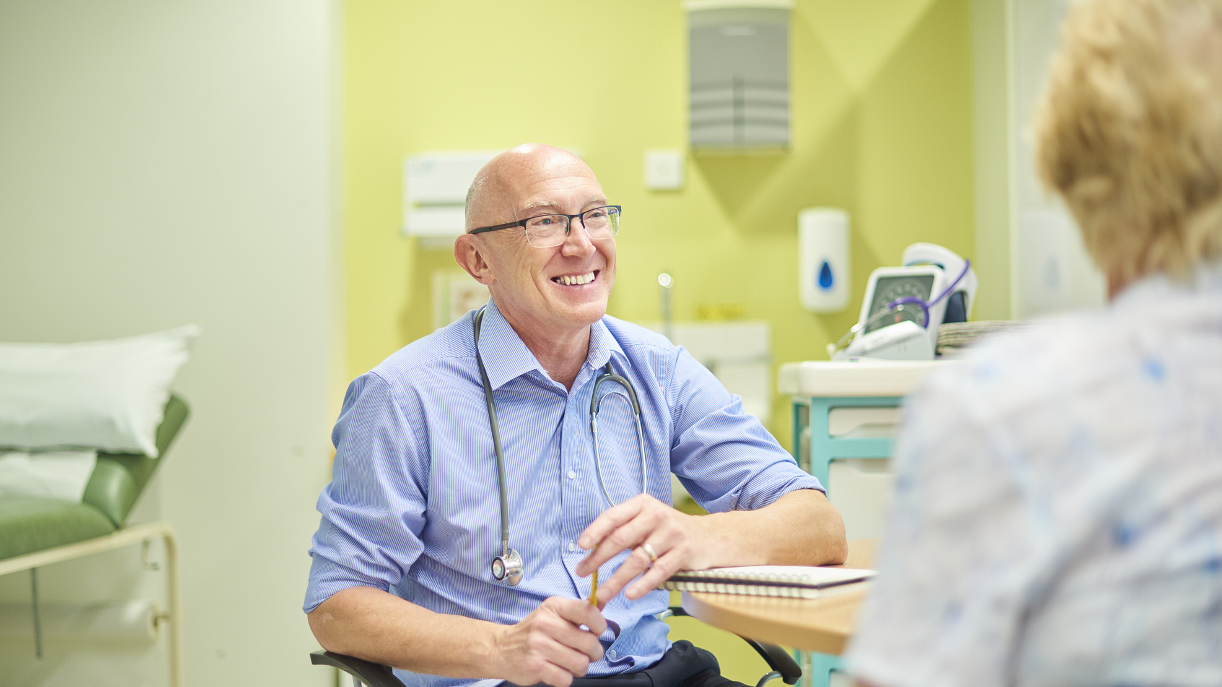

To be there for you whenever you need us.

Slide 4

To deliver continuity of care, and bring back a time when patients knew their doctors.

Slide 5

To spare patients the anxiety of long waits.

Slide 6
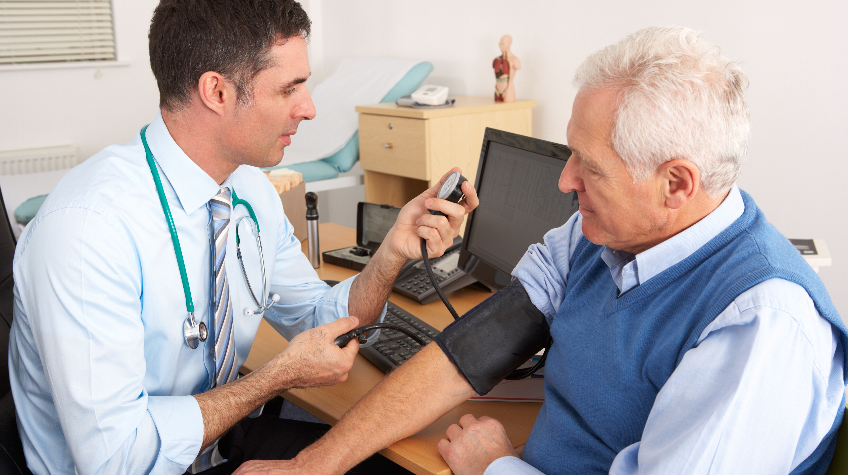
To keep things simple, so patients have the choice to call us up, send us a message or just walk in.

Slide 7
Why do many patients find it so hard to access their GP?
General Practice is being broken

Slide 8
GPs and their teams are exhausted and losing morale. No matter how many hours we work, we still can’t see all the patients that need our care.

Slide 9
The past decade has seen us lose over 1,000 GP surgeries and over 10,000 fewer GPs
The Government promised us 6,000 more GPs at the last general election, but the numbers are still going down

Slide 10
Those GPs left working in the NHS are overworked and undervalued and feel it is unsafe working in these conditions.
When they leave, it creates a vicious circle where patients struggle to get access.

Slide 11
Practices' funding has been cut by over £660 million since 2019*, with
no funding for essential services
no funding for more GPs or practice nurses
*in real terms, since 2019/20 (CPI)

Slide 12
The Government have imposed a contract on GPs that is resulting in:
more local practices closing
more GPs leaving
access for patients getting worse and worse

Slide 13
We want patients to
stand side by side with us call for a return to the GP services we used to be proud of.

Slide 14
We need your help in supporting our calls of Government to provide the funding for:
More GPs
More Nurses
More Staff
Modern practice buildings
More appointments for patients

Slide 15
We know patients deserve better than this
GPs Are On Your Side
bma.org.uk/GPsOnYourSide

